Slide 1


Intro to Transformer Architecture

Slide 2

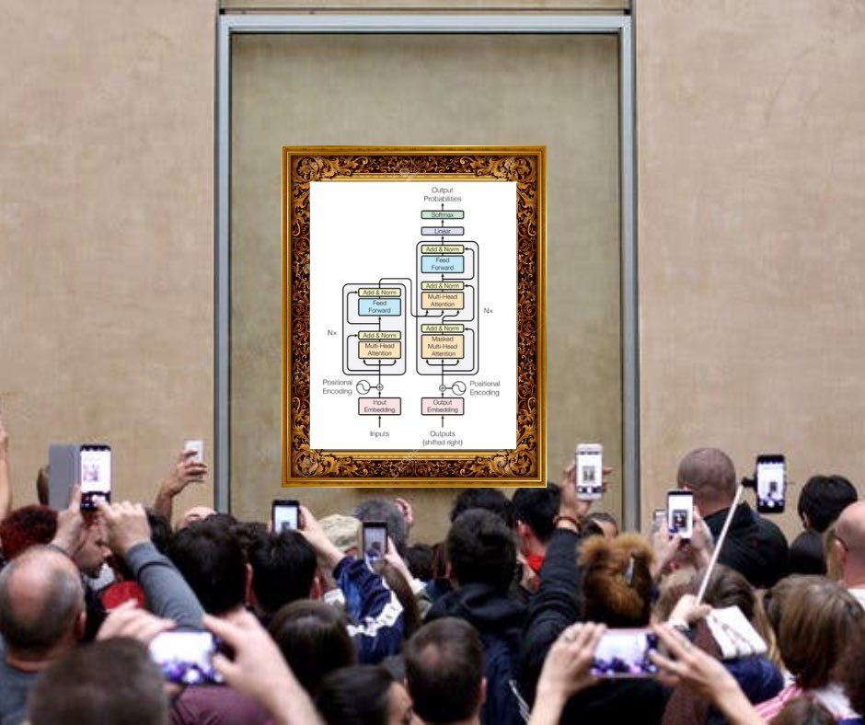
https://x.com/mishig25/status/1549859201207484417/photo/1

Slide 3


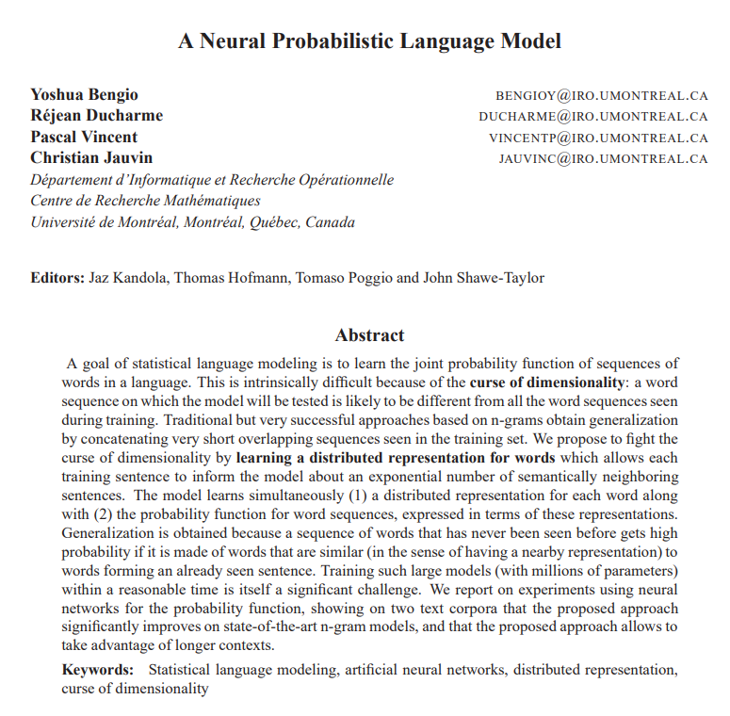
A goal of statistical language modeling is to learn the joint probability function of sequences of words in a language. This is intrinsically difficult because of the curse of dimensionality: a word sequence on which the model will be tested is likely to be different from all the word sequences seen during training. Traditional but very successful approaches based on n-grams obtain generalization by concatenating very short overlapping sequences seen in the training set. We propose to fight the curse of dimensionality by learning a distributed representation for words which allows each training sentence to inform the model about an exponential number of semantically neighboring sentences. The model learns simultaneously (1) a distributed representation for each word along with (2) the probability function for word sequences, expressed in terms of these representations. Generalization is obtained because a sequence of words that has never been seen before gets high probability if it is made of words that are similar (in the sense of having a nearby representation) to words forming an already seen sentence. Training such large models (with millions of parameters) within a reasonable time is itself a significant challenge

Slide 4
seq2seq
“J'aime le Rock'n'Roll.”
seq2seq model
“I like Rock n Roll.”
“म रक एण रोल मनपराउछु”
“Me gusta el Rock n Roll.”
Predict an output sequence from an input sequence of different length.
There is no guarantee that the input sequence is the same length, or even the same order as the output sentence.

Slide 5
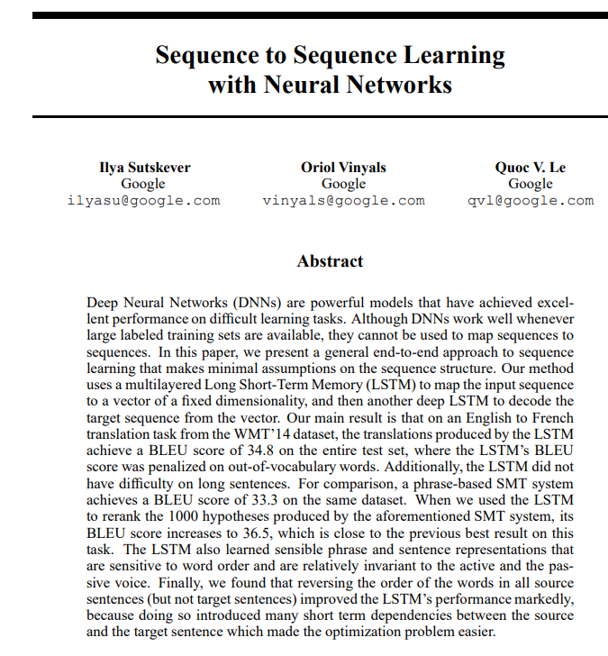
Although DNNs work well whenever large labeled training sets are available, they cannot be used to map sequences to sequences. In this paper, we present a general end-to-end approach to sequence learning that makes minimal assumptions on the sequence structure. Our method uses a multilayered Long Short-Term Memory (LSTM) to map the input sequence to a vector of a fixed dimensionality, and then another deep LSTM to decode the target sequence from the vector.

Slide 6


RNNs
Two issues:
Parallelization issue with dependence on the seq index
Linear interaction distance
https://web.stanford.edu/class/cs224n/readings/cs224n-self-attention-transformers-2023_draft.pdf

Slide 7
Parallelization issue
Parallelization Issues with Sequence Dependence
GPUs excel at parallel computations: They can handle many simple operations simultaneously, making them ideal for tasks like matrix multiplication.
Key to parallelization: Independent operations: Operations need to be independent of each other's results for true parallel execution. In matrix multiplication (AB), most multiplications and sums are independent.
RNNs and sequence dependence: Traditional RNNs have a sequential nature. Computing the hidden state (h) at a later step (e.g., h2) depends on the hidden state from the previous step (h1).
Bottleneck for GPUs: As sequence length grows, the number of serial dependencies in RNNs prevents full utilization of a GPU's parallel processing power.

Slide 8
Linear Interaction Distance in RNNs
Limited interaction between distant tokens: RNNs struggle for distant words (tokens) in a sequence to influence each other's processing.
Example: In "the number of intermediate computations—matrix multiplies and nonlinearities, for example—that separate chef from is," the impact of "chef" on understanding "is" weakens with the increasing number of words between them.
Challenge in remembering: RNNs might struggle to precisely recall a word's influence after many operations.
Impact on representation: This limits the model's ability to learn how distant words affect the current word's representation.

Slide 9
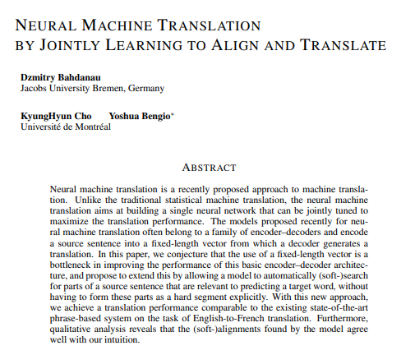
In this paper, we conjecture that the use of a fixed-length vector is a bottleneck in improving the performance of this basic encoder–decoder architecture, and propose to extend this by allowing a model to automatically (soft-)search for parts of a source sentence that are relevant to predicting a target word, without having to form these parts as a hard segment explicitly.

Slide 10
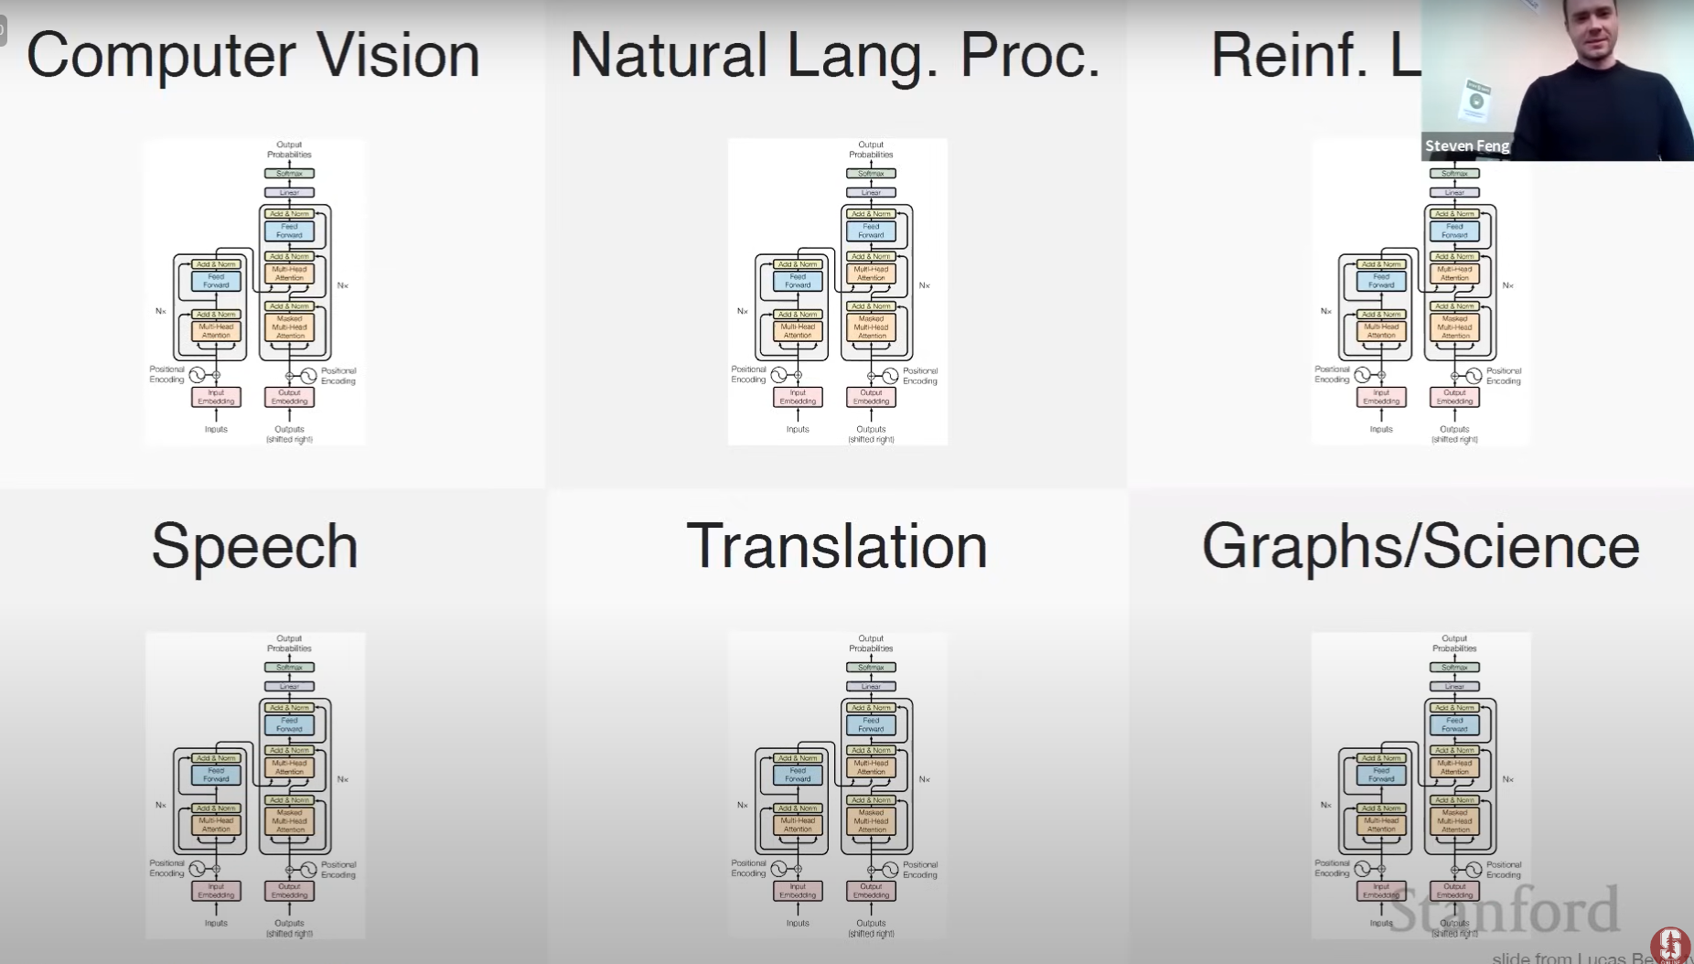

Slide 11
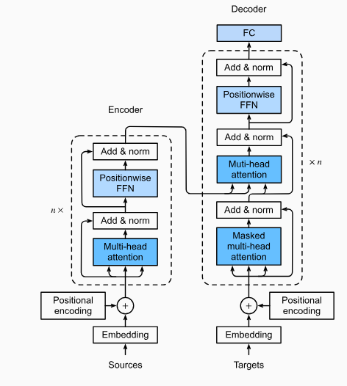
Encoder:
Takes an input sequence of symbols (x1, ..., xn). These symbols could be words, characters, or any other element you want the model to understand.
Each symbol is represented by a vector (x1, ..., xn). These vectors could be word embeddings or any other encoding capturing the meaning of the symbol.
The encoder maps this input sequence to a new sequence of continuous representations (z1, ..., zn). These continuous representations are denser and capture more complex information about the input sequence compared to the original symbol vectors.

Slide 12
Decoder:
Takes the encoded sequence (z = z1, ..., zn) from the encoder as input.
Generates an output sequence (y1, ..., ym) one element (symbol) at a time. At each step, it predicts the next symbol in the output sequence.
Auto-regressive: This means the decoder uses the previously generated symbols (y1, ..., yi-1) to predict the next symbol (yi). In simpler terms, the model uses what it has generated so far to inform its prediction for the next element.

Slide 13
Analogy: Imagine you're summarizing a long article.
The encoder is like reading the article and creating condensed notes capturing the key points (encoded sequence).
The decoder is like writing the summary one sentence at a time. As you write each sentence, you consider the previous sentences you've written to ensure your summary flows coherently (auto-regressive).

Slide 14
Encoder
FFN
Layer Norm
Attention
FFN
Positional Encoding
Layer Norm
Attention
Embedding
Tokenization
Input

Slide 15
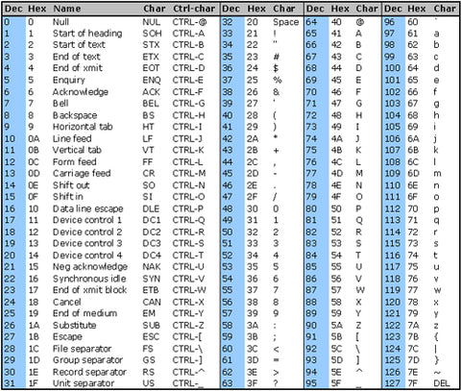
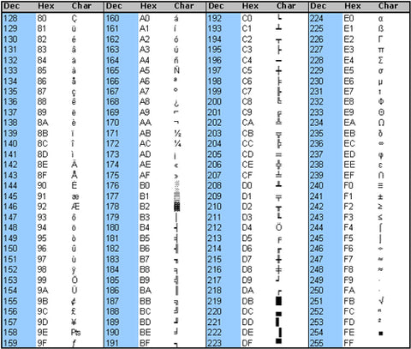
FFN
Output
Tokenization
Layer Norm
Tokenization
Attention
Byte Pair Encoding (BPE) Tokenization is a tokenization technique that starts with a base vocabulary and iteratively merges the most frequent pairs of bytes or characters to form new tokens.
This helps in efficiently compressing text and handling out-of-vocabulary words.
FFN
Positional Encoding
Layer Norm
Embedding
Attention
Tokenization
Input
Consider an input. [(“cat”, 10), (“sat”, 5), (“at”, 2), (“the”, 7), (“mat”, 6), (“there”, 3)] with their frequency.
The base vocab will consist of unique set of symbols used to write those words. [c, a, t, s, h, e, m, r]
Traditional character-level tokenization looks at words as sequences of Unicode characters. However, byte-level BPE treats text as a sequence of bytes. This means it breaks down the text into its raw byte representation.
Since there are 256 possible byte values (0-255), the initial vocabulary consists of these 256 bytes. This is significantly smaller than a typical character-based vocabulary, which might include thousands of characters from various languages.

Slide 16
During the tokenizer training process, the BPE algorithm continuously identifies the most common combination of two adjacent tokens within a word. This frequent pair is then merged, and the algorithm iterates this process, searching for the next most common pair to merge, until the training is complete.
[(‘c’, ‘a’, ‘t’, 10), (‘s’, ‘a’, ‘t’, 5), (‘a’, ‘t’ , 2), (‘t’, ‘h’, ‘e’, 7), (‘m’, ‘a’, ‘t’, 6), (‘t’, ‘h’, ‘e’, ‘r’, ‘e’, 3)]
BPE search for the most repeated pair in the vocab set [c, a, t, s, h, e, m, r]
[(‘ca’, ‘at’, 10), (‘sa’, ‘at’, 5), (‘at’ , 2), (‘th’, ‘he’, 7), (‘ma’, ‘at’, 6), (‘th’, ‘he’, ‘er’, ‘re’, 3)]
‘ca’ repeated 10 times | ‘at’ repeated 10+5+2+6 = 23 times | ‘sa’ repeated 5 times | ‘th’ repeated 7+3 =10 times | ‘he’ repeated 7 + 3 = 10 times | ‘ma’ repeated 6 times | ‘er’ repeated 3 times | ‘re’ repeated 3 times
First rule the BPE learns is to combine ‘a’ and ‘t’
Now vocab becomes [c, at, s, h, e, m, r]
Corpus: [(‘c’, ‘at’, 10), (‘s’, ‘at’, 5), (‘at’ , 2), (‘t’, ‘h’, ‘e’, 7), (‘m’, ‘at’, 6), (‘t’, ‘h’, ‘e’, ‘r’, ‘e’, 3)]
Again search for the most repeated pair in : [(‘c’, ‘at’, 10), (‘s’, ‘at’, 5), (‘at’ , 2), (‘th’, ‘he’, 7), (‘m’, ‘at’, 6), (‘th’, ‘he’, ‘er’, ‘re’, 3)]
(‘c’, ‘at’) : 10 | (‘s’, ‘at’): 5 | (‘t’, ‘h’): 10 | (‘h’, ‘e’): 10 | (‘m’, ‘at’): 6 | (‘e’,’r’): 3, (‘r’, ‘e’): 3
Vocab: [cat, s, h, e, m, r]
Corpus: : [(‘cat’, 10), (‘s’, ‘at’, 5), (‘at’ , 2), (‘t’, ‘h’, ‘e’, 7), (‘m’, ‘at’, 6), (‘t’, ‘h’, ‘e’, ‘r’, ‘e’, 3)]
(‘cat’) : 10 | (‘s’, ‘at’): 5 | (‘t’, ‘h’): 10 | (‘h’, ‘e’): 10 | (‘m’, ‘at’): 6 | (‘e’,’r’): 3, (‘r’, ‘e’): 3
Vocab: [cat, s, th, e, m, r]
Corpus: [(‘cat’, 10), (‘s’, ‘at’, 5), (‘at’ , 2), (‘th’, ‘e’, 7), (‘m’, ‘at’, 6), (‘th’, ‘e’, ‘r’, ‘e’, 3)]
And we continue till the desired vocab size is reached.

Slide 17
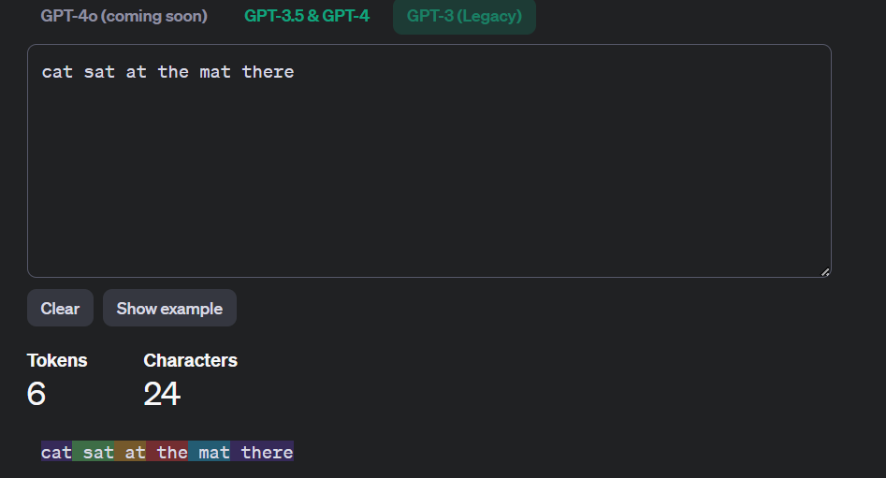
https://platform.openai.com/tokenizer

Slide 18
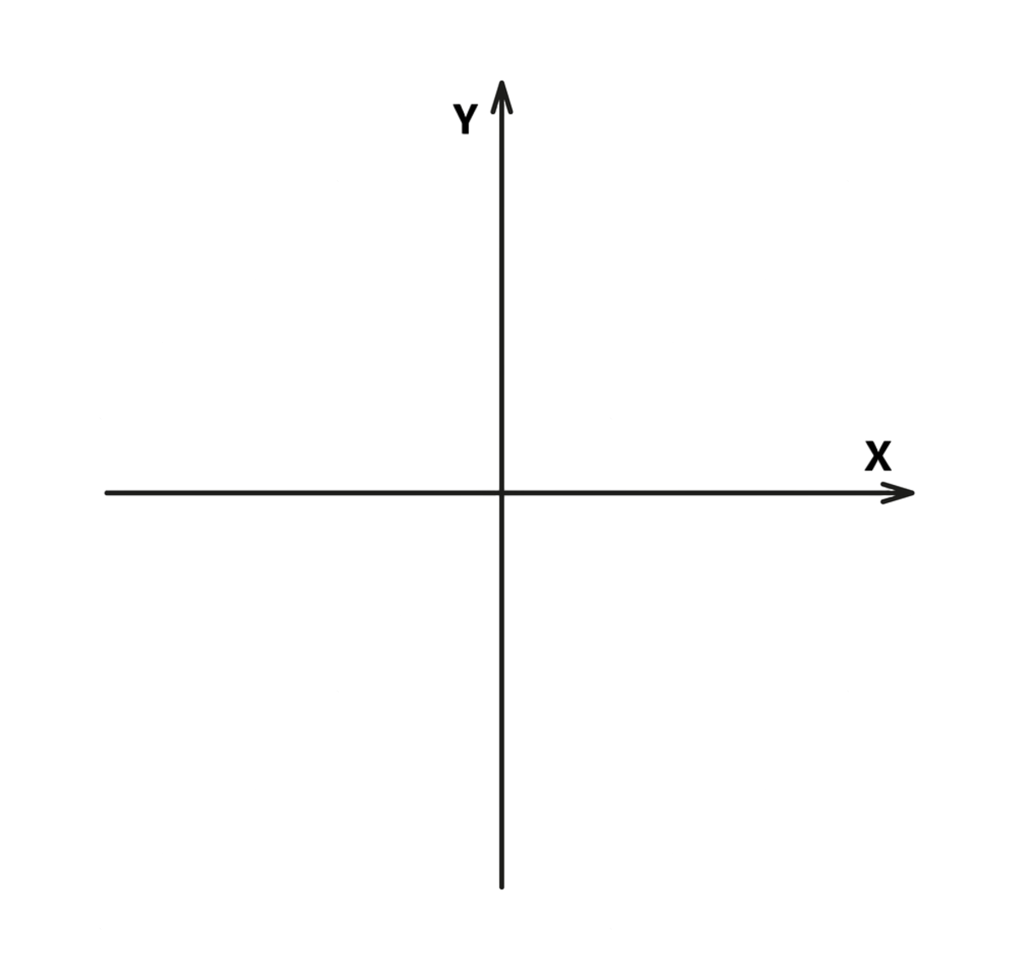
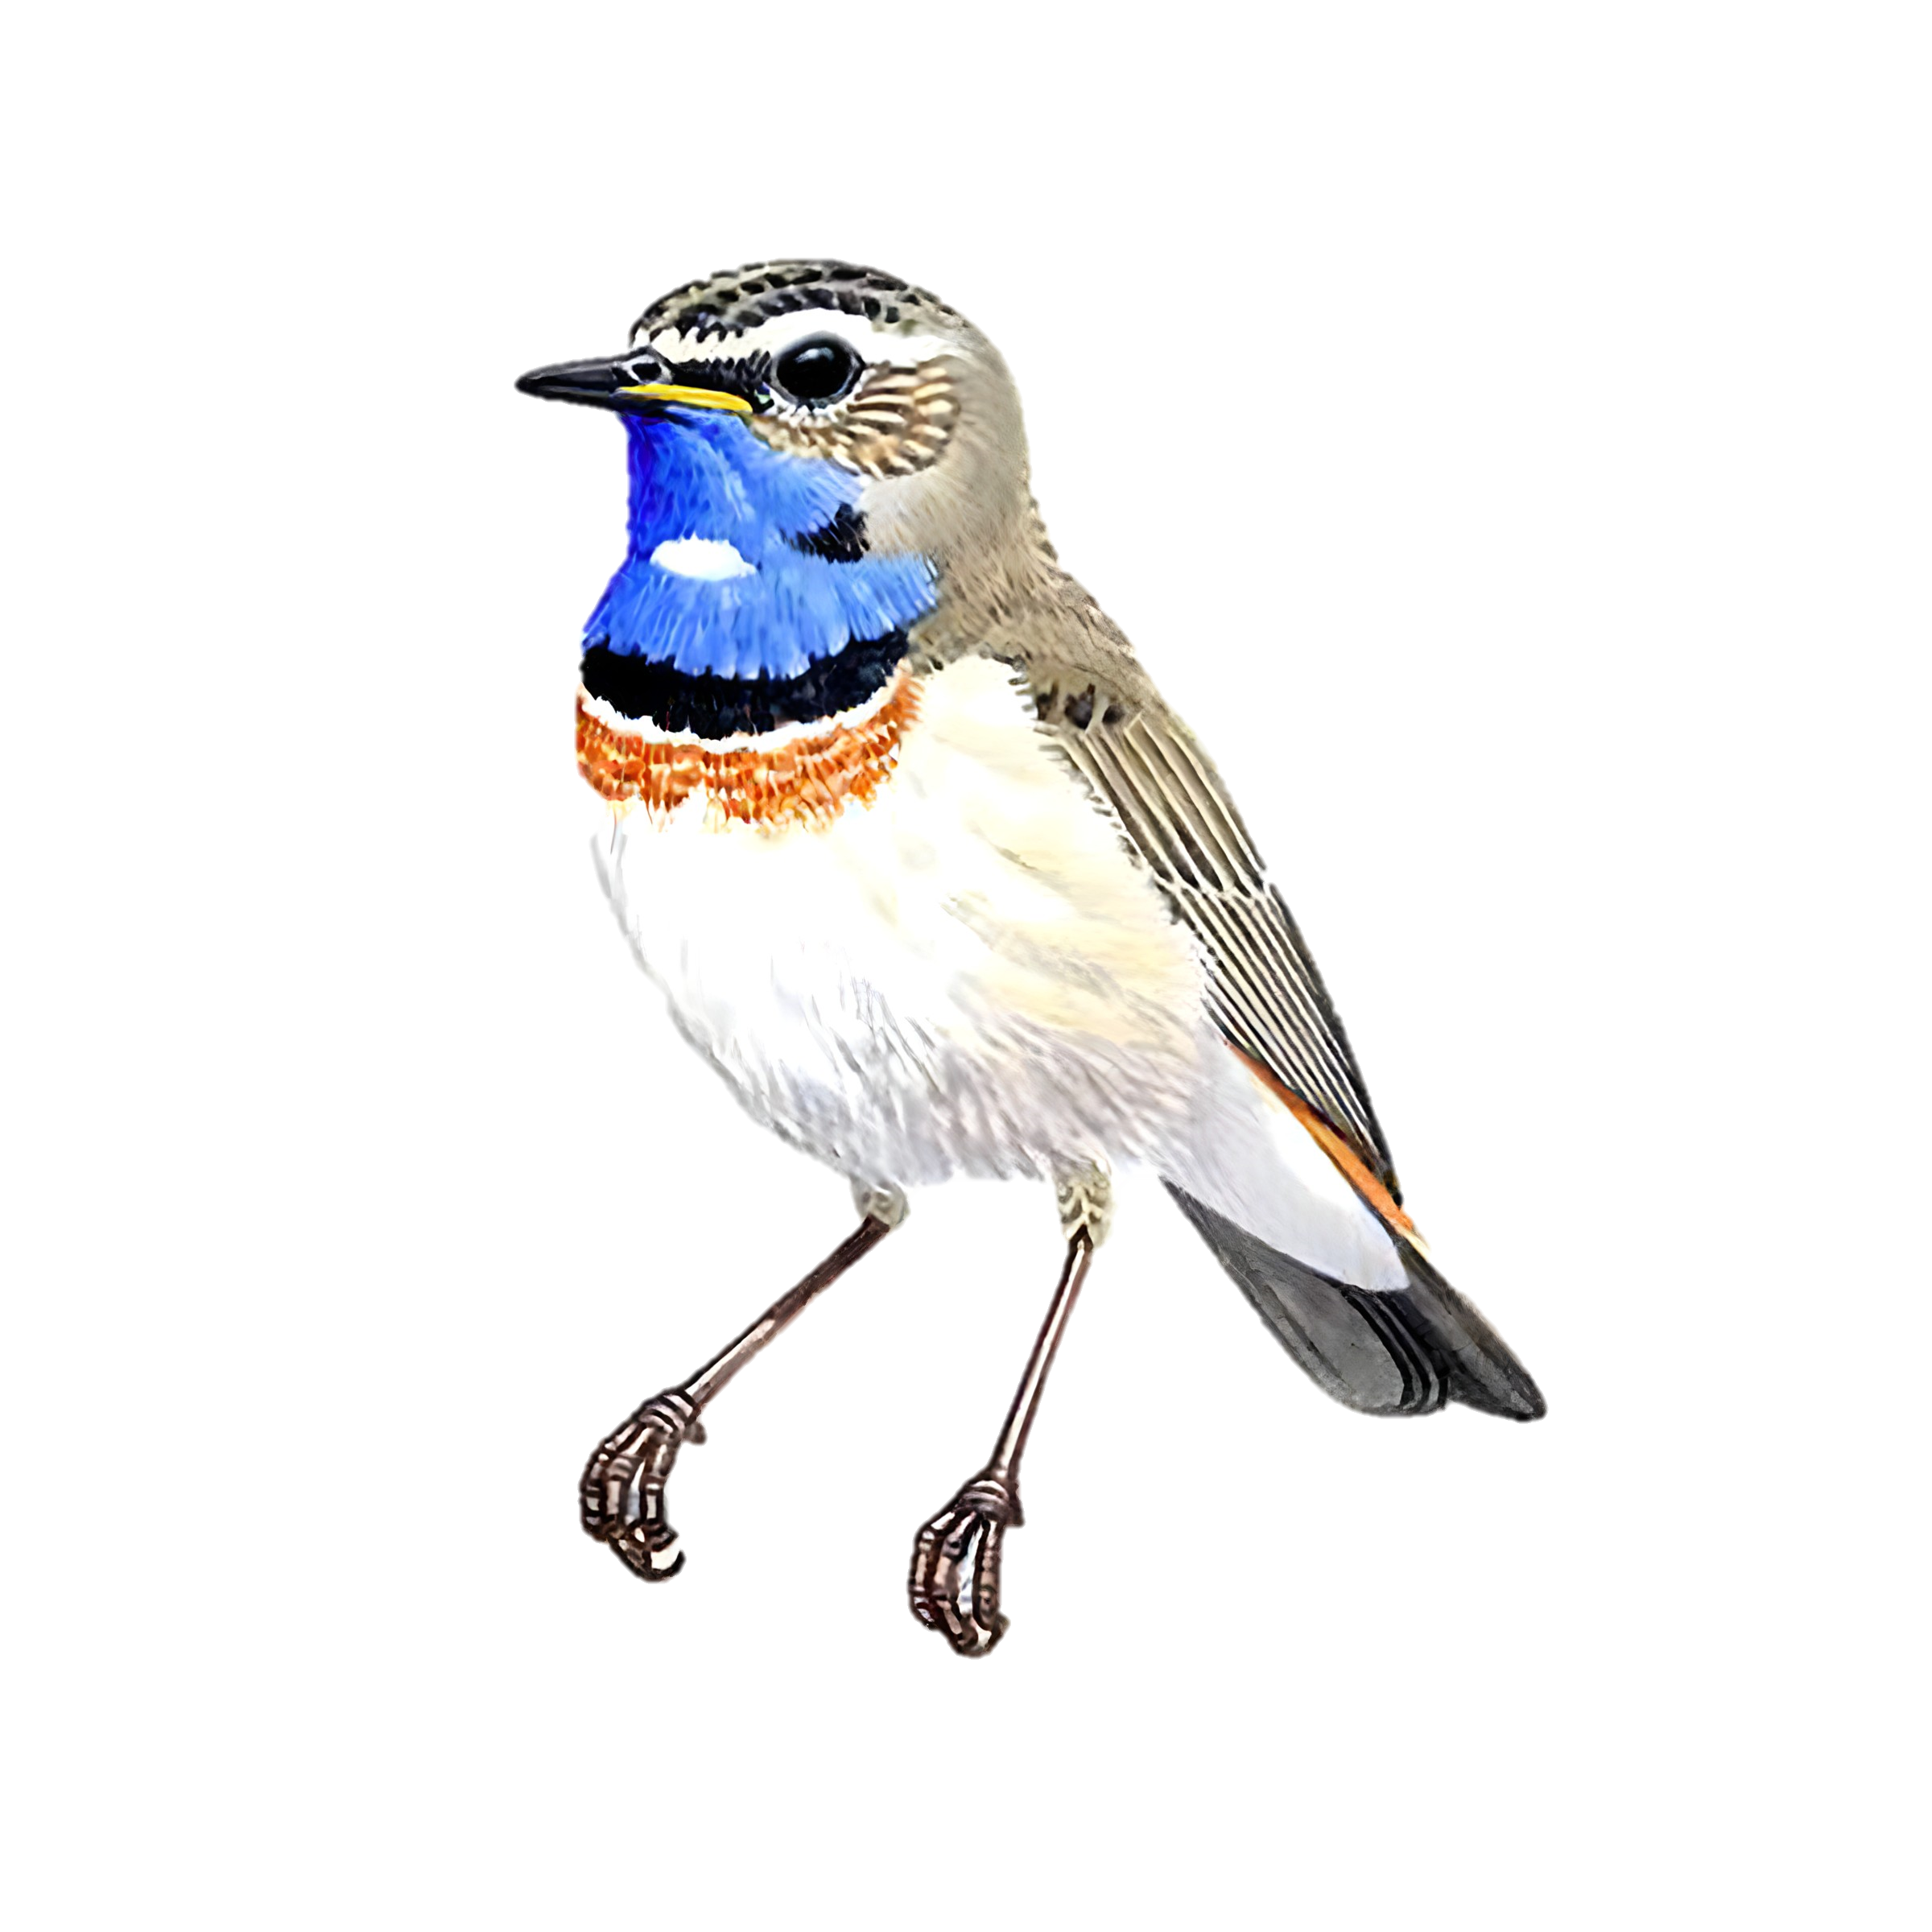
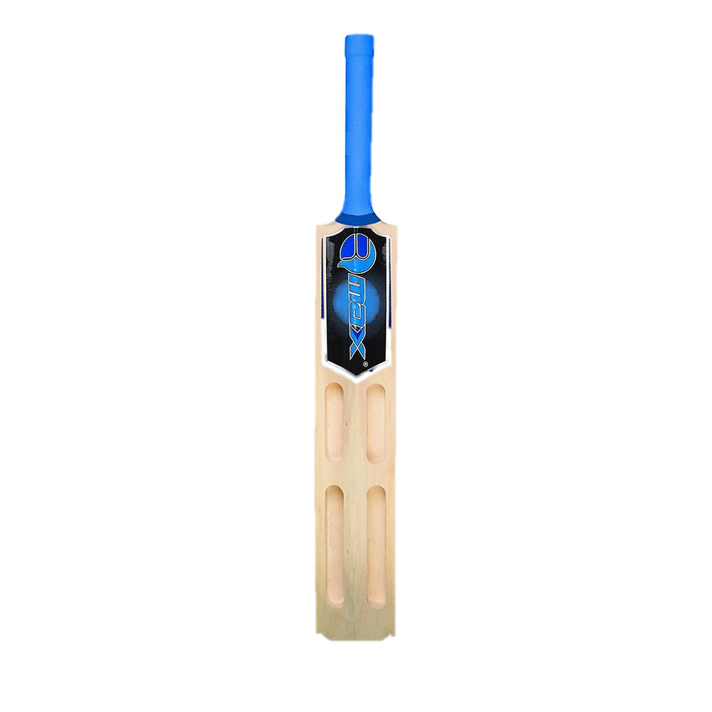


FFN
Output
Embedding
Layer Norm
Tokenization
Attention
Embeddings are vector representations of real-world objects.
What should be the embedding of bat?
Depends on the context:
My cricket bat
A bat bit me.
Similar words have similar position in the embedding space. They are close to each other. Dissimilar words are far away from each other.
FFN
Positional Encoding
Layer Norm
Embedding
Attention
Tokenization
Input

Slide 19
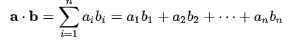

How to measure similarity
Dot Product
My cricket bat
bat bit me
[my, cricket, bat, bit, me]
Assume the axis represent some quantity. X – Wings Y – Bounce and in the embedding space they have coordinates:
Bird – [4,0] Football – [0,4], Bat – [3,2]
Dot product(bird, bat) = [4,0] . [3,2] = 12
Dot product(ball, bat) = [0,4],[3,2] = 8
Scaled Dot Product
Divide the similarity score by square root of the length of the vector
closer
farther

Slide 20
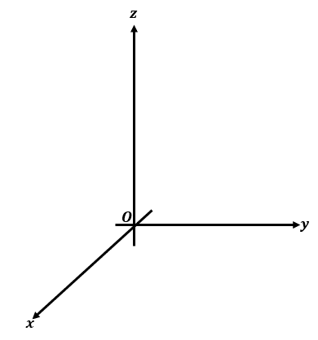
My cricket bat
bat bit me
[my, cricket, bat, bit, me]
my
me
bat
bat
 | Sport | Bird | Other
my | 0 | 0 | 3
cricket | 3 | 0 | 0
bat | 2 | 2 | 0
bit | 0 | 4 | 0
me | 0 | 0 | 2
bit
cricket

Slide 21
 | Cricket | bit | bat | me | my
cricket | 1 | 0 | 0.8 | 0 | 0
bit | 0 | 1 | 0.8 | 0 | 0
bat | 0.8 | 0.8 | 1 | 0 | 0
me | 0 | 0 | 0 | 1 | 1
my | 0 | 0 | 0 | 1 | 1
 | Cricket | bat | my
cricket | 1 | 0.8 | 0
bat | 0.8 | 1 | 0
my | 0 | 0 | 1
 | bit | bat | me
bit | 1 | 0.8 | 0
bat | 0.8 | 1 | 0
me | 0 | 0 | 1
My cricket bat
Cricket -> 1 * cricket + 0.8 * Bat
Bat -> 0.8*cricket+1*bat
Bat bit me
bit -> 1 * bit + 0.8 * Bat
Bat -> 0.8*bit+1*bat

Slide 22
My cricket bat
Bat -> 0.6*cricket+0.4*bat
We are taking 60% of the bat and converting it to cricket.
This means moving embedding vector of bat 60% towards cricket when the context is ‘my cricket bat’
Bat bit me
Bat -> 0.6*bit+0.4*bat
We are taking 60% of the bat and converting it to bit.
This means moving embedding vector of bat 60% towards cricket when the context is ‘bat bit me’

Slide 23
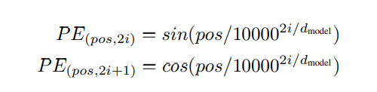
FFN
Output
Positional Embedding
Layer Norm
Tokenization
Attention
FFN
Positional Encoding
Layer Norm
Embedding
Attention
Tokenization
Input
Tagging the words with a value to remember their position
Ideally, the following criteria should be satisfied:
It should output a unique encoding for each time-step (word’s position in a sentence)
Distance between any two time-steps should be consistent across sentences with different lengths.
Our model should generalize to longer sentences without any efforts. Its values should be bounded.
It must be deterministic.
For a position 𝑝𝑜𝑠 and a dimension 𝑖 of the encoding, the positional encoding 𝑃𝐸(𝑝𝑜𝑠,𝑖) is defined as:
For even indices (i.e., 𝑖=2𝑗):
For odd indices (i.e., 𝑖=2𝑗+1):

Slide 24
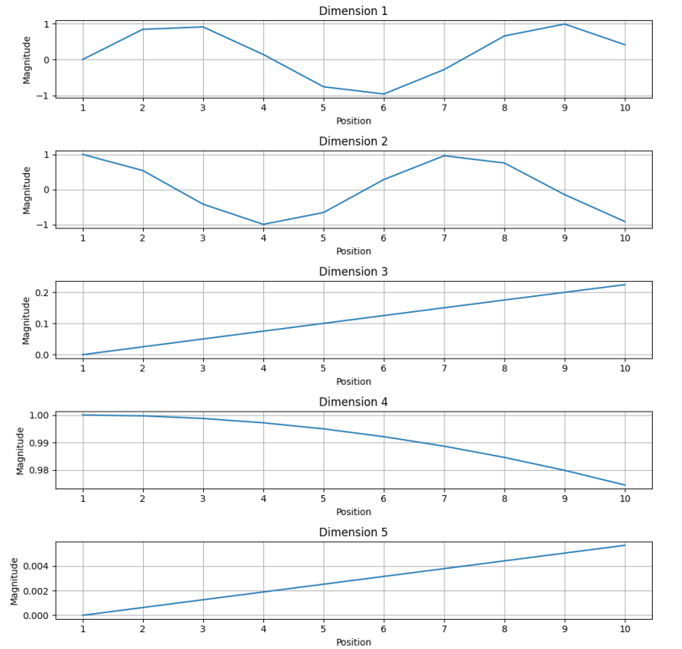
For example, assume we have embedding vectors of length 5 in 5-dim:
[0.3,0.3,0.2,0.1,0.1] [0.5,0.1,0.1,0.1,0.1,0.1] and so on…
 | pos | i
0.3 | 0 | 1 | Even | sin(0/10000^(2*1)/2)
0.3 | 1 | 1 | Odd | cos(1/10000^(2*1)/2)
0.2 | 2 | 1 | Even | sin(2/10000^(2*1)/2)
0.1 | 3 | 1 | Odd | cos(3/10000^(2*1)/2)
0.1 | 4 | 1 | Even | sin(4/10000^(2*1)/2)
0.5 | 0 | 2 | Even | sin(0/10000^(2*2)/2)
0.1 | 1 | 2 | Odd | cos(1/10000^(2*2)/2)
0.1 | 2 | 2 | Even | sin(2/10000^(2*2)/2)
0.1 | 3 | 2 | Odd | cos(3/10000^(2*2)/2)
0.1 | 4 | 2 | Even | sin(4/10000^(2*2)/2)

Slide 25
The absolute values are not unique. However, in reality the positional values are unique.
The positional encodings are added to the embeddings to create the input matrix for the attention layer of the transformer.

Slide 26
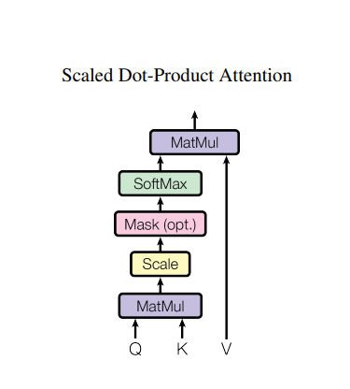
FFN
Output
Self-attention
Layer Norm
Tokenization
Attention
FFN
In general terms, Self-Attention works by seeing how similar each word is to all of the words in the sentence, including itself.
Positional Encoding
Layer Norm
Embedding
Attention
Tokenization
Input
Role of attention layer is to add context.
I play with a cricket bat.
Attention layer adds context to ensure that the embedding vector is correctly aligned i.e. it is closer to the vector sub-space of cricket than the vector sub-space of birds.

Slide 27
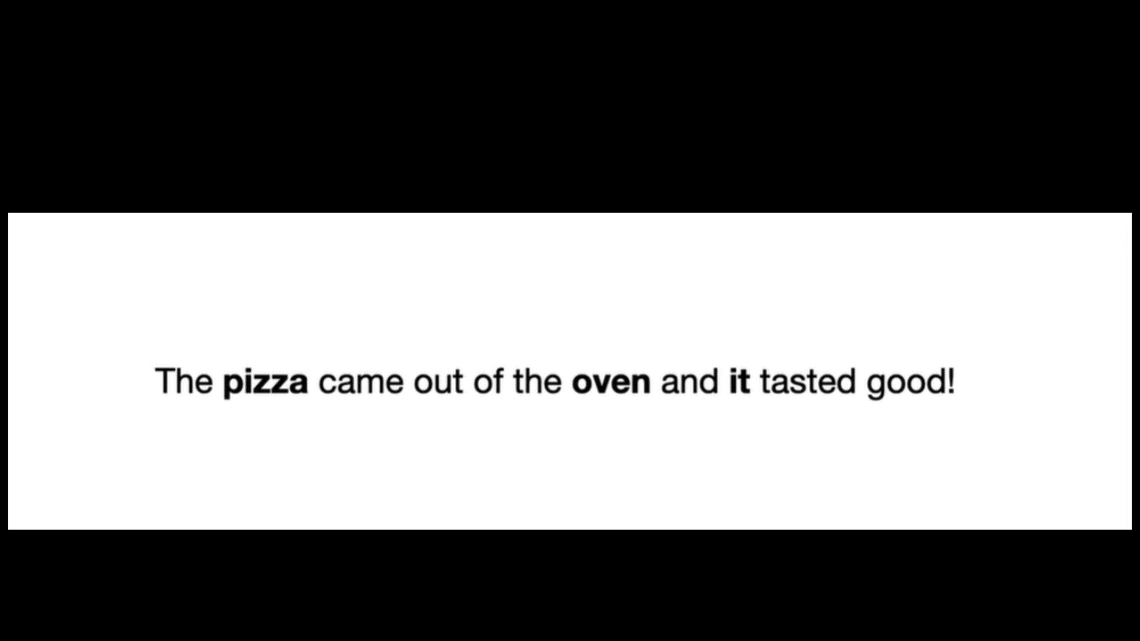

Slide 28
it
X1
x1
oven
SOFTMAX
X2
x2
pizza
X3
x3
it

Slide 29
Softmax
Softmax is a mathematical function that takes in a vector of real numbers and outputs a vector of values in the range [0, 1] that add up to 1.
softmax(x) = exp(x) / Σ exp(x) for vector x
Suppose we have an input vector x = [2, 4, 6, 8]. We want to apply the softmax function to this vector.
Calculate the exponentials: exp(x) = [e^2, e^4, e^6, e^8] = [7.38, 54.59, 403.43, 2980.96]
Calculate the sum: Σ exp(x) = 7.38 + 54.59 + 403.43 + 2980.96 = 3446.36
Divide each exponential value by the sum: softmax(x) = [7.38/3446.36, 54.59/3446.36, 403.43/3446.36, 2980.96/3446.36] = [0.021, 0.158, 0.117, 0.864]

Slide 30
The key/value/query concept is analogous to retrieval systems. For example, when you search for videos on Youtube, the search engine will map your query (text in the search bar) against a set of keys (video title, description, etc.) associated with candidate videos in their database, then present you the best matched videos (values).

Slide 31
Keys
it
X1
x1
oven
SOFTMAX
X2
x2
pizza
X3
x3
Query
it

Slide 32
Let w_{1:n} be a sequence of words in vocab V.
V : The pizza came out of the oven and it tasted good.
For each w_{i}, let x_{i} = Ew_{i}, where E has dimensions d x |V|. d is the model dimension.
1. Transform each word embedding with weight matrices Q, K, V with dim d x d
q_{i} = Q x_{i} k_{i} = K x_{i} v_{i} = V x_{i}
2. Compute pairwise similarities between keys and queries, normalize with softmax:
e_{ij} = q_{i}^{T} k_{j} α_{ij} = exp(e_{ij}) / ∑exp(e_{ij})
3. Compute output for each word as weighted sum of values
o_{i} = ∑α_{ij} v_{j}
Notes:
This is not the whole picture. We have used values which are constant. However we need to learn something about these matrices.

Slide 33
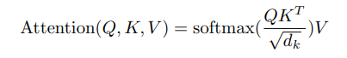
While Q and K matrices compute the similarity by providing a transformation to the matrices in which the vectors have the maximum separation. It knows features of the words.
The V matrix adds the context back to the vectors. It provides the best embedding for finding the next word. It knows when two words could appear in the same context.

Slide 34
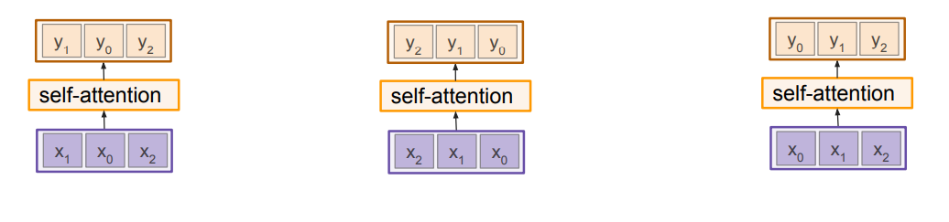
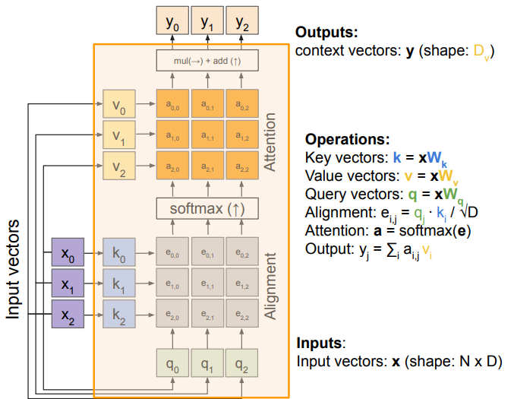
Permutation invariant. Hence, positional encoding is needed.

Slide 35
FFN
Output
Add & Layer Normalization
Layer Norm
Tokenization
Attention
FFN
Positional Encoding
Layer Norm
Embedding
Attention
The residual connection is a shortcut path that allows the input of a layer to bypass the operations within the layer and be added directly to the layer's output.
This helps in mitigating the vanishing gradient problem and allows the network to learn more effectively by preserving the original input information.
Layer normalization aims to normalize the inputs of each layer, not just the inputs to individual neurons. This is different from batch normalization, which normalizes across a mini-batch of data.
For a given layer with inputs 𝑥 ∈ 𝑅^{𝑑} (where 𝑑 is the number of neurons in the layer), the layer normalization process involves the following steps:
Tokenization
Input

Slide 36
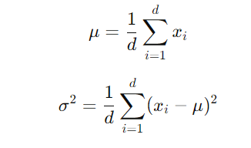
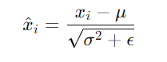
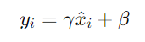
Compute Mean and Variance: Calculate the mean 𝜇 and variance 𝜎² of the input activations across the features (neurons) in the layer:
Normalize: Normalize the input activations using the computed mean and variance
Scale and Shift: Apply parameters 𝛾 (scale) and 𝛽 (shift) to the normalized values. These values are learned.

Slide 37
FFN
Output
Feed Forward Neural Net
Layer Norm
Tokenization
Attention
FFN
Positional Encoding
Layer Norm
Embedding
Attention
Tokenization
Input
The Feed Forward Neural Network (FFNN) in each encoder and decoder layer can be defined by the following steps:
Input: The input to the FFNN is the output from the previous after it has undergone the Add & Norm step.
Linear Transformation: The input is projected into a higher-dimensional space. This is typically done using a linear layer (also known as a dense layer). If the input has a dimension of 𝑑_{model}​, the output dimension is often increased to 𝑑_{ff} where 𝑑_{ff}​ is usually much larger than 𝑑_{model}​.

Slide 38
ReLU Activation: A ReLU (Rectified Linear Unit) activation function is applied to introduce non-linearity. This allows the network to learn more complex patterns.
Linear Transformation: The activated output is projected back to the original input dimension 𝑑_{model}.
Output: The final output is then passed through another Add & Norm layer before being sent to the next block in the transformer.
Mathematically, this can be represented as:
FFNN(x)=Linear₂​(ReLU(Linear₁​(x)))

Slide 39
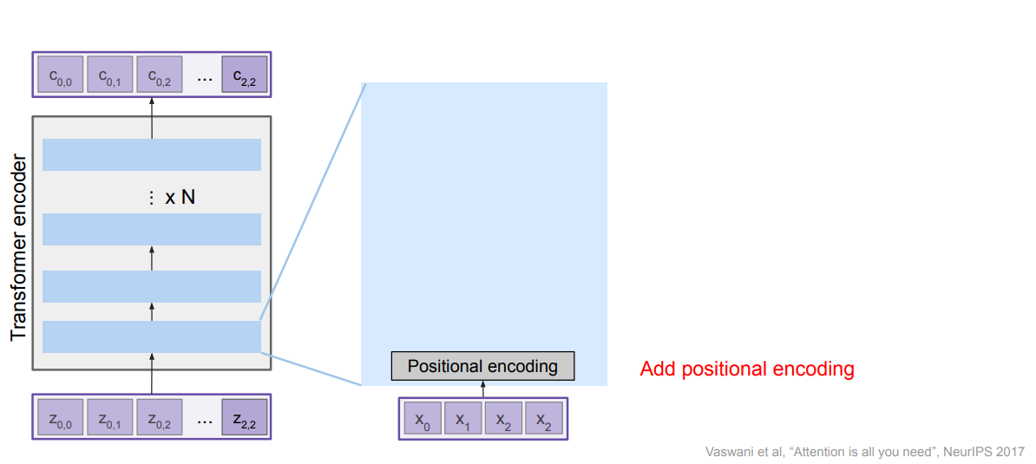

Slide 40
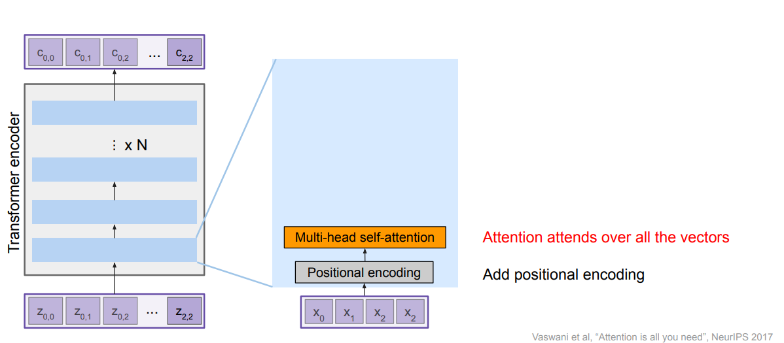

Slide 41
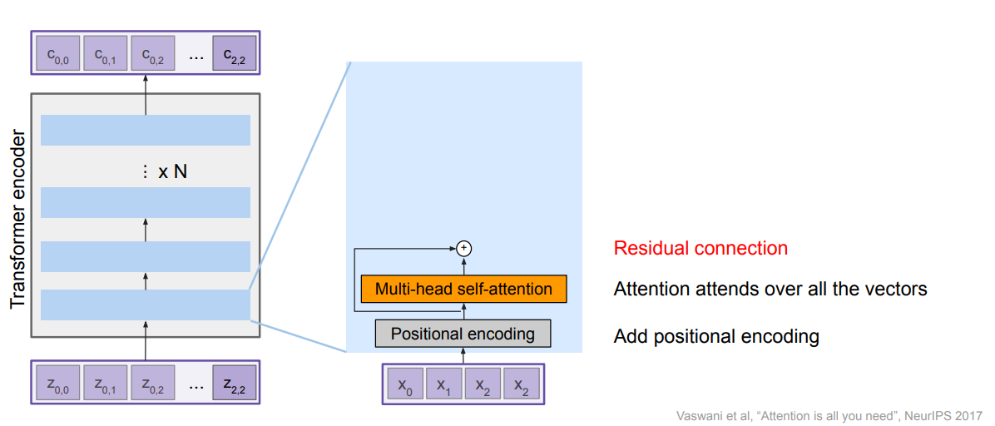

Slide 42
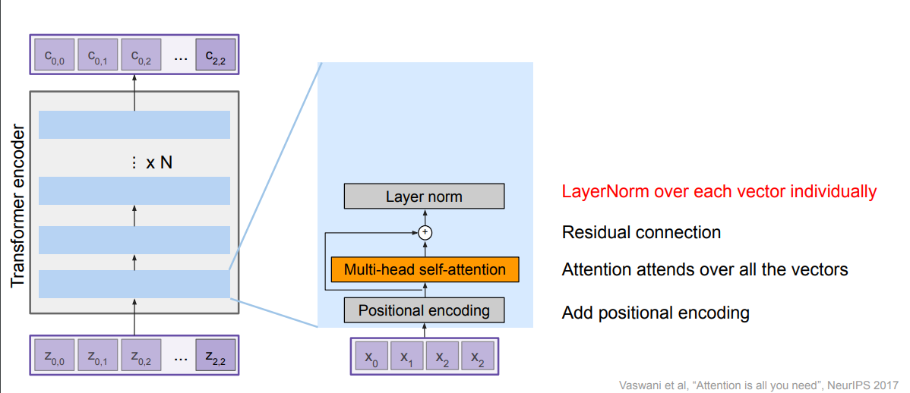

Slide 43
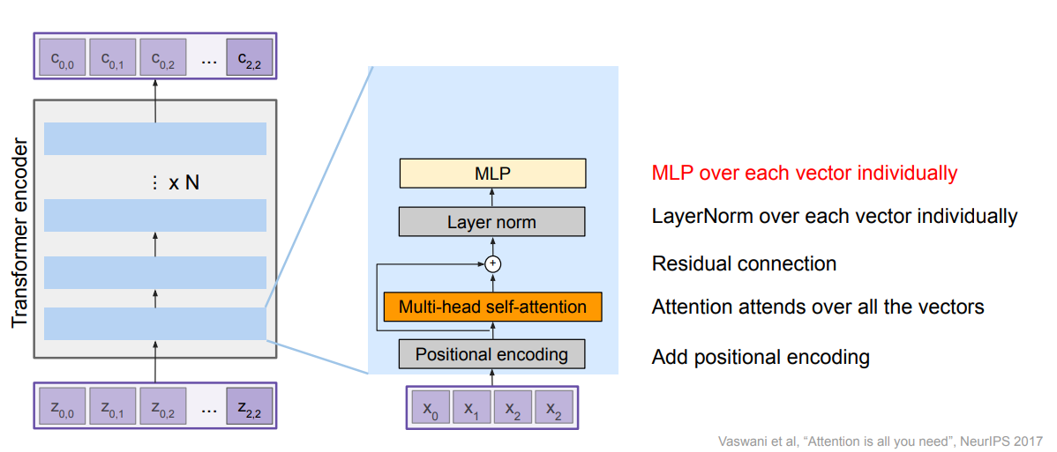

Slide 44
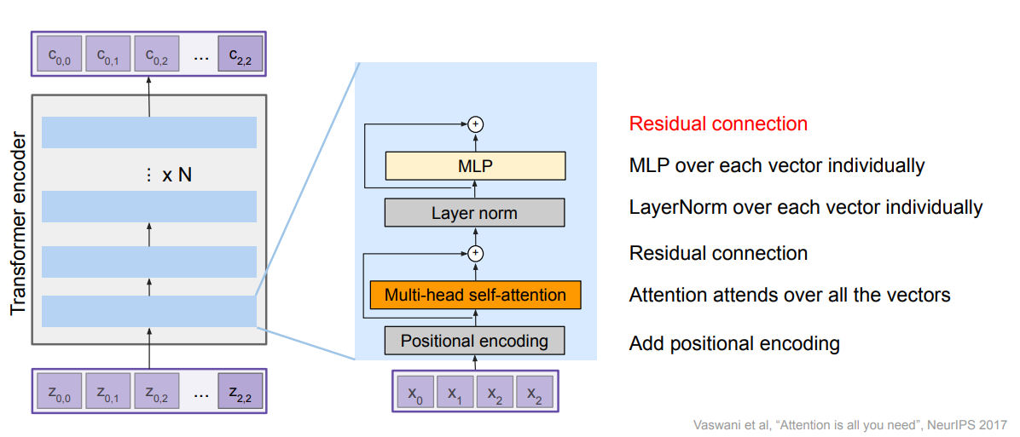

Slide 45
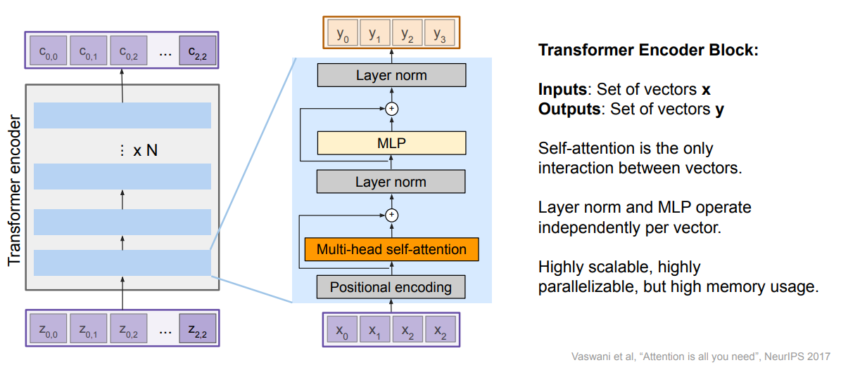

Slide 46
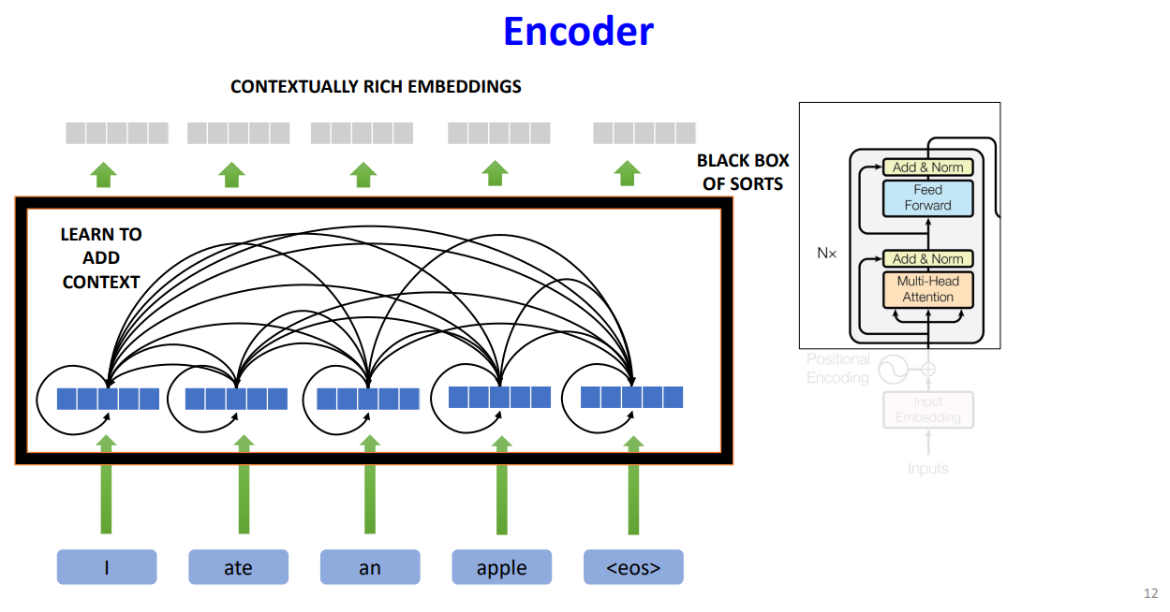
https://deeplearning.cs.cmu.edu/F23/document/slides/lec19.transformersLLMs.pdf

Slide 47
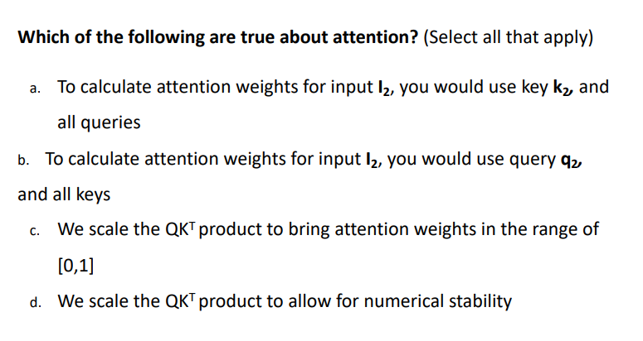
Quick question

Slide 48
Decoder
The encoder processes the input sequence (e.g., a sentence in the source language) and produces a series of context vectors, one for each input token. These context vectors form the keys (K) and values (V) for the cross attention mechanism.
The decoder processes the partially generated output sequence up to the current position and produces an intermediate representation. This serves as the query (Q).
Similar to self-attention, the decoder's intermediate representation is linearly projected to form the query matrix (Q).
The encoder's output is linearly projected to form the key (K) and value (V) matrices.

Slide 49
Cross Attention
In the transformer model, the decoder is responsible for generating the output sequence (e.g., a translated sentence).
Cross attention allows the decoder to focus on relevant parts of the encoder's output while generating the sequence.
To do this effectively, it needs to attend to the context provided by the encoder's output (the representation of the input sequence).
Cross attention enables this by allowing the decoder to use the encoder's output as the key (K) and value (V) in the attention mechanism, while the decoder's own intermediate states serve as the query (Q).

Slide 50
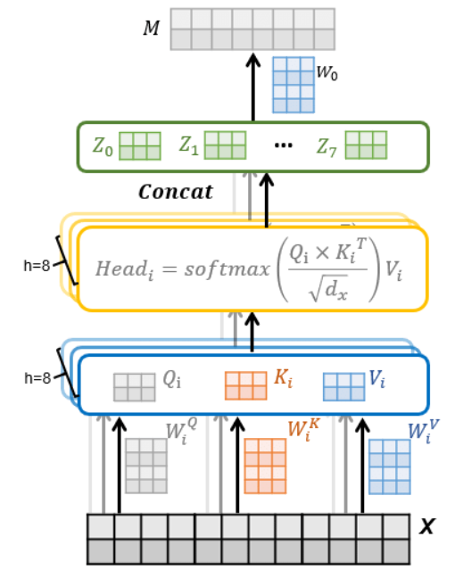
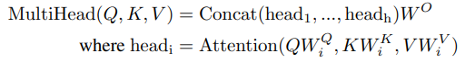
Multi head attention
Allows the model to focus on different parts of the input sequence simultaneously, providing multiple perspectives for capturing relationships between tokens.
Linear Projections:
The input sequence is linearly projected into multiple sets of queries, keys, and values.
These projections are performed independently for each attention head.
If the input has dimensionality 𝑑_{model} ​ and there are ℎ heads, each projection reduces the dimensionality to 𝑑_{𝑘}=𝑑_{model}/ℎ.
https://www.researchgate.net/profile/A-X/publication/334427742/figure/fig3/AS:987861692211201@1612535989364/Structure-of-multi-head-attention-layer.ppm

Slide 51
For each head, we calculate the attention scores using Q, K, V matrices.
Concatenating the outputs of all heads results in a combined representation that incorporates different aspects of the input sequence.
Input→Q, K, V→Attention Weights→Weighted Sum→Output
Input→Q, K, V for each head→Attention Weights for each head→Weighted Sum for each head→Concatenate Heads→Final Linear Projection→Output

Slide 52
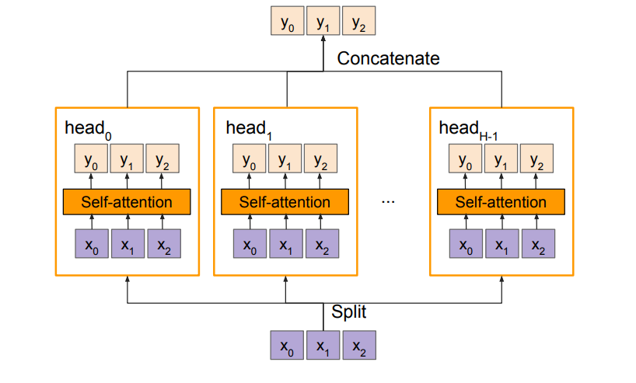
https://cs231n.stanford.edu/slides/2022/lecture_11_ruohan.pdf

Slide 53
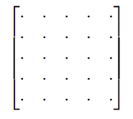
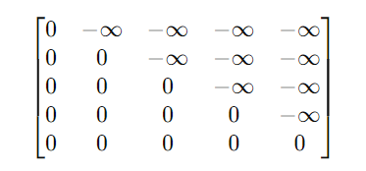
Masked Multi Head Attention
A specialized attention mechanism used in the transformer's decoder to ensure that each position in the output sequence can only attend to previous positions and itself, not future positions.
After creating Q,K,V matrices and computing attention scores, Use a mask to set the attention scores of future positions to negative infinity (−∞−∞).
Masked Scores = Attention Scores+Mask

Slide 54
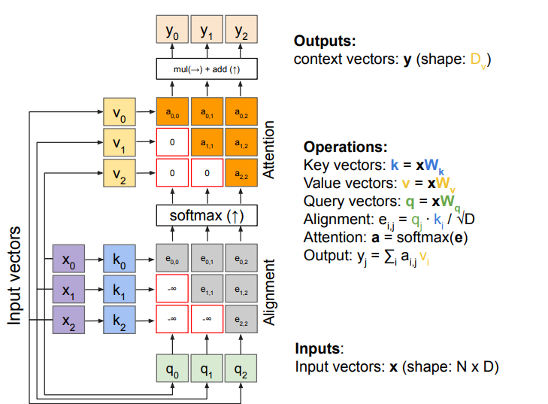
This ensures the softmax operation zeroes out these scores, effectively ignoring future positions.
Ensures that each position in the sequence only attends to previous positions and itself, maintaining the correct order of information flow.

Slide 55
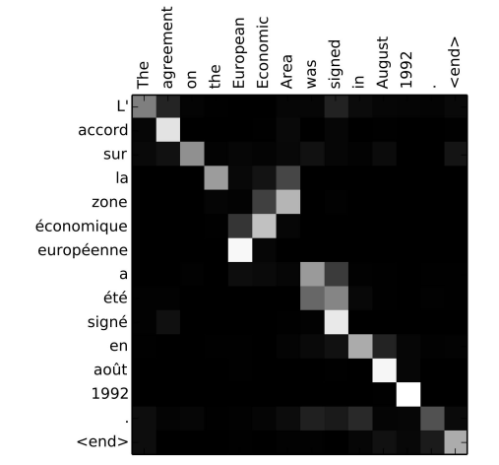
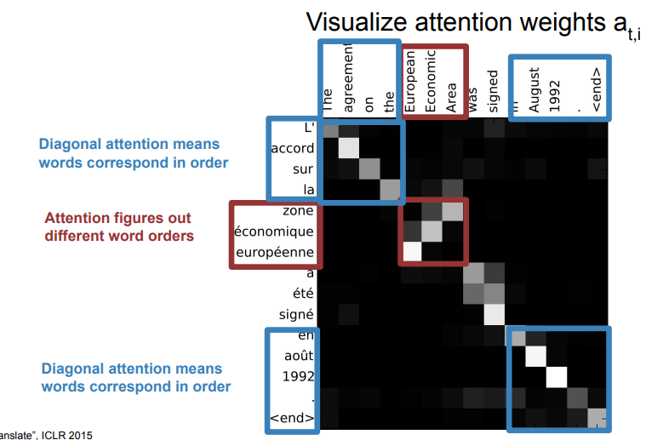
https://cs231n.stanford.edu/slides/2022/lecture_11_ruohan.pdf

Slide 56
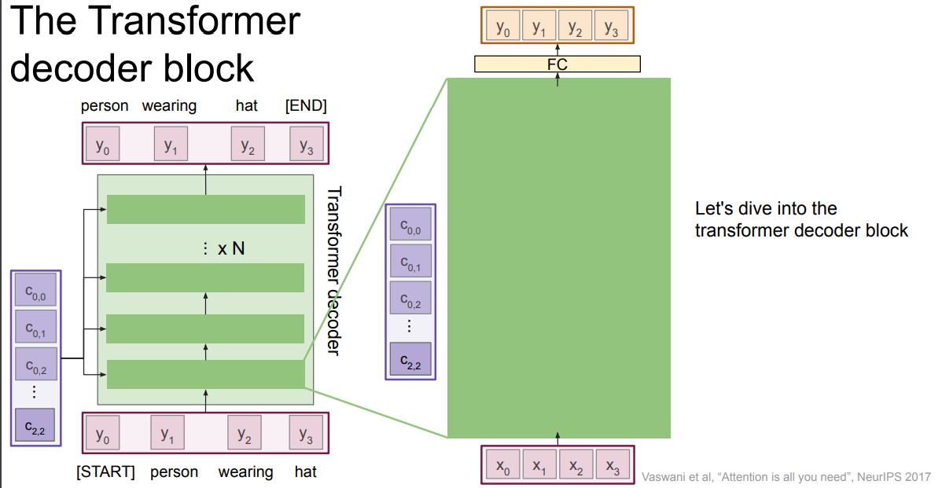

Slide 57
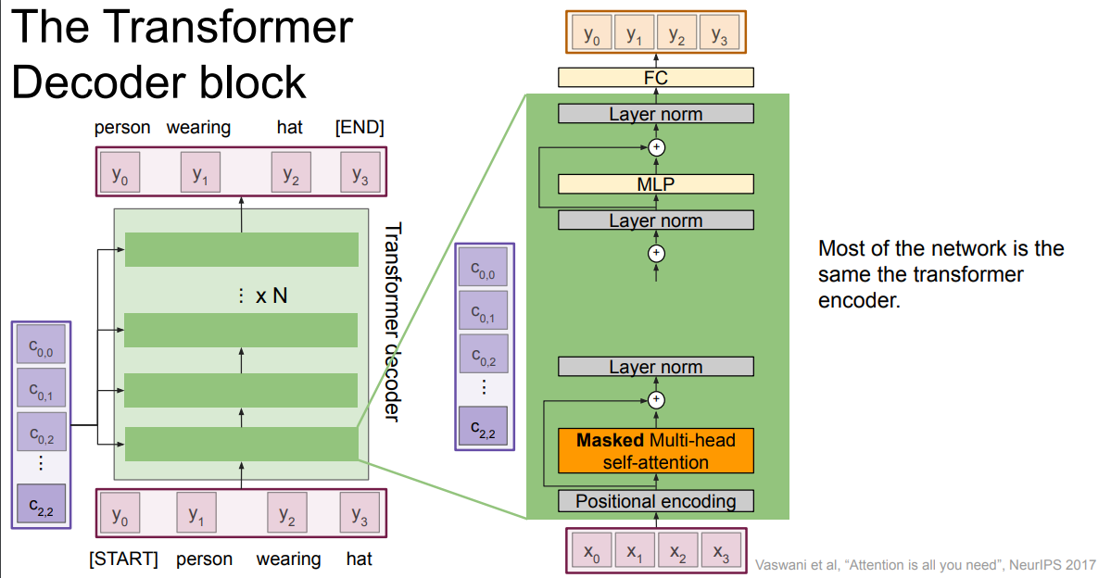

Slide 58
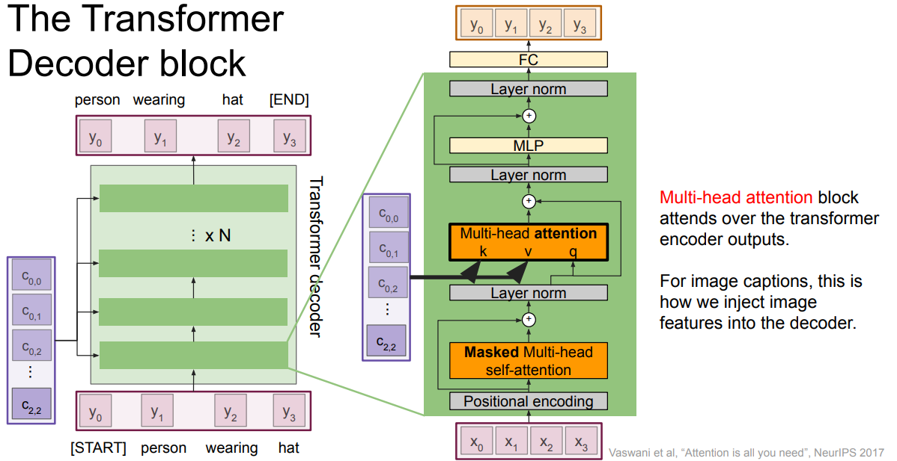

Slide 59
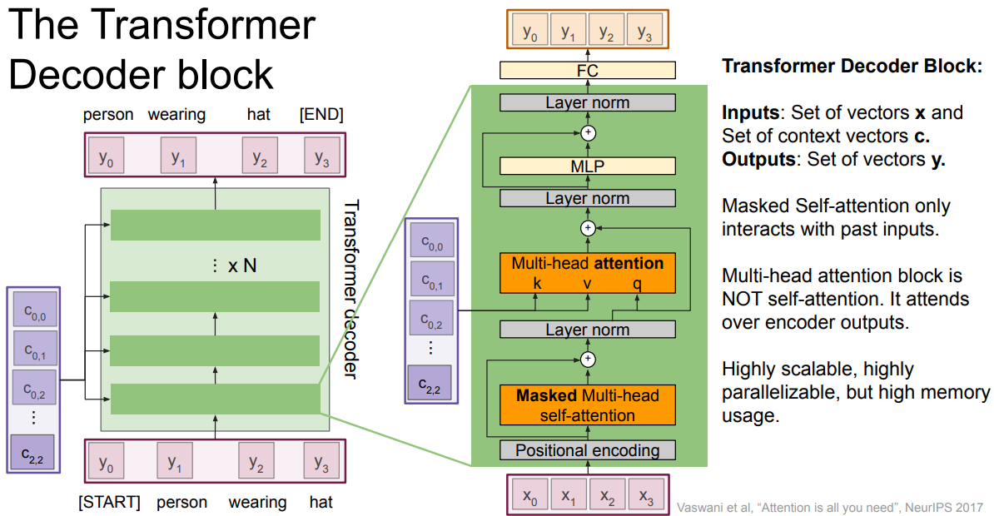

Slide 60
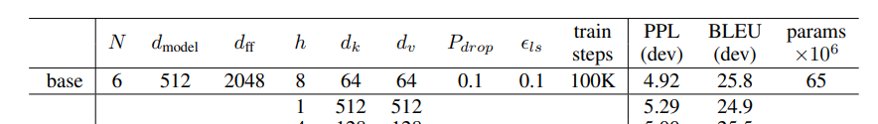

Slide 61
Attention Visualized

Slide 62
https://bbycroft.net/llm

Slide 63
Flash Attention
Transformer Bottleneck:
The core of a transformer, the self-attention mechanism, becomes a hurdle when dealing with long sequences. Standard attention calculates relationships between each element in the sequence with every other element. This quadratic complexity leads to significant slowdowns and memory limitations as sequence length increases.

Slide 64
FlashAttention: Fast and Memory-Efficient Exact Attention with IO-Awareness
Fast – “We train GPT2 3x faster than baseline implementation from HF.”
Memory Efficient – Attention is quadratic. This method is linear.
Exact – Not an approximation of the mechanism
IO Aware – Leverages the knowledge of hardware

Slide 65
Depending on this ratio between computation and memory accesses, operations can be classified as either:
compute-bound (example: matrix multiplication)
memory-bound (examples: elementwise ops (activation, dropout, masking), reduction ops (softmax, layer norm, sum, etc.)…)
attention is memory-bound - it “mostly consists of elementwise ops”

Slide 66
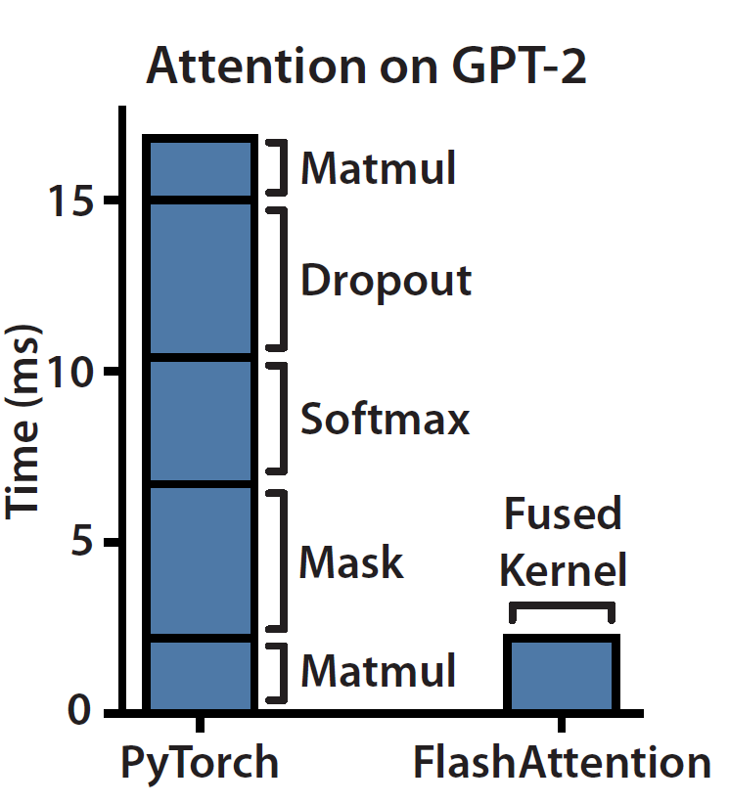
masking, softmax & dropout are the ops that are taking the bulk of the time and not matrix multiplication

Slide 67
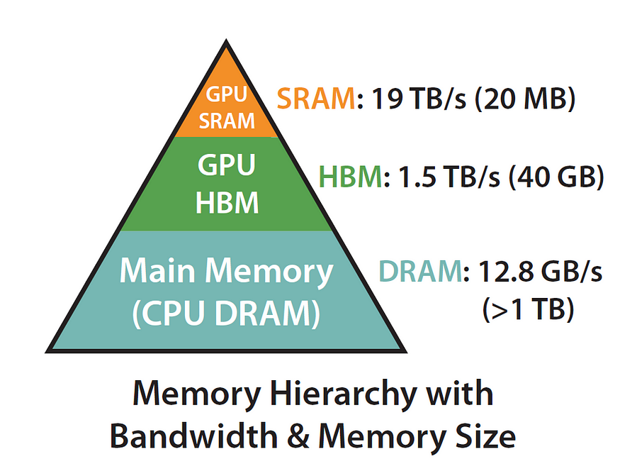
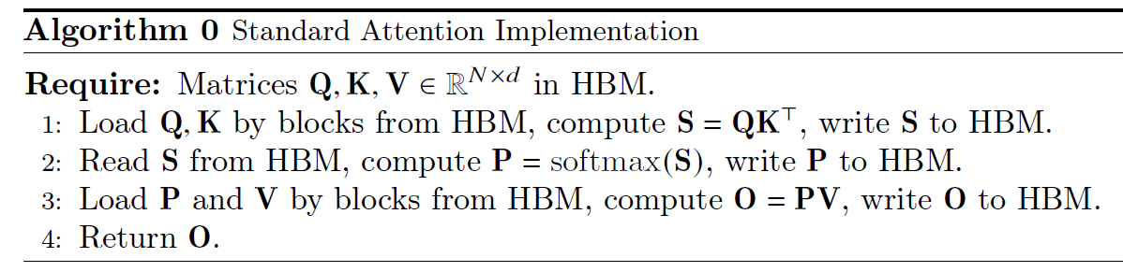
The lowest hanging fruit is to remove redundant HBM reads/writes.
Why write S back to HBM only to (re)load it again in order to compute the softmax? Let’s keep it in SRAM instead, perform all of the intermediate steps, and only then write the final result back to HBM.

Slide 68
Flash attention boils down to 2 main ideas:
Tiling (used during both forward & backward passes) — basically chunking the NxN softmax/scores matrix into blocks.
Recomputation

Slide 69
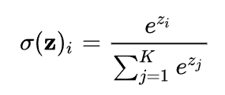
The main hurdle in getting the tiling approach to work is softmax.
To compute how much a particular i-th token from the input sequence pays attention to other tokens in the sequence you’d need to have all of those scores readily available (denoted here by z_j) in SRAM.
the trick is we can actually chop the softmax computation down into smaller blocks and still end up with precisely the same result.

Slide 70
We can grab only the first B scores (x_1 through x_B) and compute the softmax for them.
Then we can combine those per-block partial softmax numbers in a smart way such that the final result is actually correct.

Slide 71
Reduced Memory Access: A major contributor to slowdowns in attention is the constant loading and unloading of data (queries, keys, and values) from memory during computations. FlashAttention addresses this by loading all the data required for the attention operation just once. This eliminates redundant data movement and reduces memory access overhead.
Focus on Final Results: Once the data is loaded, FlashAttention performs all the necessary calculations within memory to obtain the attention scores. Only the final results are written back to memory. This minimizes unnecessary memory usage and streamlines the process.
https://github.com/Dao-AILab/flash-attention

Slide 72


Slide 73
Ref
https://github.com/jessevig/bertviz?ref=ghost.oxen.ai
https://proceedings.neurips.cc/paper/2017/file/3f5ee243547dee91fbd053c1c4a845aa-Paper.pdf
https://cs231n.stanford.edu/slides/2022/lecture_11_ruohan.pdf
https://deeplearning.cs.cmu.edu/F23/document/slides/lec19.transformersLLMs.pdf
https://www.youtube.com/watch?v=UPtG_38Oq8o
https://www.youtube.com/watch?v=bCz4OMemCcA
https://www.youtube.com/watch?v=zxQyTK8quyY

Slide 74
Hands-on
Recreate nanoGPT
https://www.youtube.com/watch?v=kCc8FmEb1nY
Or
https://nlp.seas.harvard.edu/2018/04/03/attention.html

Slide 75
Key Value Cache

Slide 76
Caching
In computing, a cache is a high-speed data storage layer which stores a subset of data, typically transient in nature, so that future requests for that data are served up faster than is possible by accessing the data’s primary storage location. Caching allows you to efficiently reuse previously retrieved or computed data.
https://aws.amazon.com/caching/

Slide 77

• Auto-regressive text generation is the process used by LLMs to generate text in a sequential manner, one token at a time.
• It works by iteratively:
- Taking an input sequence of tokens
- Sampling the next token based on the model's predictions
- Appending the sampled token to the input sequence
- Repeating the process until a stop token is generated
• This process is called "auto-regressive" because the model's predictions for the next token depend on the previously generated tokens, forming a self-referential or "regressive" process.

Slide 78
LLMs undergo training using the causal language modeling objective, which necessitates masking the upper triangular portion of the attention score matrix.
This ensures that tokens never depend on future tokens during training.
During generation, the query vector 𝑞_{𝑖} attends only to previous key-value vectors 𝑘_{𝑚<𝑖}, 𝑣_{𝑚<𝑖} for 𝑚 ∈ {0, …, 𝑖 − 1}.

Slide 79
Let's run a quick code snippet to show how auto-regressive works in practice. We will simply take the most likely next token via torch.argmax.
input_ids = tokenizer(prompt, return_tensors="pt")["input_ids"].to("cuda")
for _ in range(5):
next_logits = model(input_ids)["logits"][:, -1:]
next_token_id = torch.argmax(next_logits,dim=-1)
input_ids = torch.cat([input_ids, next_token_id], dim=-1)
print("shape of input_ids", input_ids.shape)
generated_text = tokenizer.batch_decode(input_ids[:, -5:])
generated_text

Slide 80
shape of input_ids torch.Size([1, 21])
shape of input_ids torch.Size([1, 22])
shape of input_ids torch.Size([1, 23])
shape of input_ids torch.Size([1, 24])
shape of input_ids torch.Size([1, 25])
[' Here is a Python function’]
As we can see every time we increase the text input tokens by the just sampled token.

Slide 81

KV caching occurs during multiple token generation steps and only happens in the decoder

Slide 82

Since the decoder is causal (i.e., the attention of a token only depends on its preceding tokens), at each generation step we are recalculating the same previous token attention, when we actually just want to calculate the attention for the new token.
By caching the previous Keys and Values, we can focus on only calculating the attention for the new token.

Slide 83
Multi – query Attention
Traditional Multi-Head Attention:
Each head has its own set of query, key, and value projections.
ℎ heads mean ℎ different sets of queries, keys, and values.
Captures different aspects of input information in parallel.
Introduces significant computational and memory overhead.
Queries:
Each head has its own distinct query vector.
Allows each head to focus on different parts of the input information.
Keys and Values:
Uses a single shared set of key and value vectors across all heads.
Reduces memory usage and computational cost.

Slide 84
Grouped Query Attention
Involves grouping multiple query vectors to share keys and values within each group.
Queries within each group share a single set of key and value vectors.
Fewer sets of keys and values than in traditional MHA but more than in MQA.
Offers potentially better performance than MQA at a slightly higher resource cost.

Slide 85
import numpy as np
import time
import torch
from transformers import AutoModelForCausalLM, AutoTokenizer
device = "cuda" if torch.cuda.is_available() else "cpu"
tokenizer = AutoTokenizer.from_pretrained("gpt2")
model = AutoModelForCausalLM.from_pretrained("gpt2").to(device)
for use_cache in (True, False):
times = []
for _ in range(10): # measuring 10 generations
start = time.time()
model.generate(**tokenizer("What is KV caching?", return_tensors="pt").to(device), use_cache=use_cache, max_new_tokens=1000)
times.append(time.time() - start)
print(f"{'with' if use_cache else 'without'} KV caching: {round(np.mean(times), 3)} +- {round(np.std(times), 3)} seconds")

Slide 86
Speculative Decoding

Slide 87


Slide 88
Speculative Decoding
You have two models – one is bigger but powerful another is smaller but quick.
Speculative Decoding uses a smaller draft model to generate ‘speculative’ tokens and use bigger ‘target’ model to verify those.
Experiments indicate performance of speculative decoding depends on the latency of the draft model.
However, the draft model’s capabilities in language modelling do not correlate with increase in performance.

Slide 89


Speculative Decoding - Deepmind and Google both discovered Speculative Decoding!!!

Slide 90

In vanilla LLM inference, after the prompt is processed into KV caches (Prefill phase), LLM generates the output token by token in an autoregressive manner (Autoregressive generation phase). In speculative decoding, a draft model is first used to generate n candidate tokens at each step (Draft token generation phase). The LLM verifies the candidate tokens and accepts k (k ≤ n) tokens (LLM verification phase). Since LLM knows all n candidate tokens in advance, this step is identical to a prefill step of length n. In both cases, this process is repeated until either an end-of-sequence (EOS) token is generated or the maximum generation limit has been reached.

Slide 91
A decoder-only LLM performs inference in two phases: a prefill phase and an autoregressivedecoding phase.
In the prefill phase, the LLM is initialized with a context or prompt, formulated as C = {c1, c2, ..., cn}, where C represents the input context and n the length of the prefill.
In the prefill phase, the model processes the whole input context in parallel and performs next-word prediction. During the autoregressive-decoding phase, the model generates new text sequentially, one token at a time, building upon the context provided in the prefill phase.
Due to its sequential nature, the autoregressive decoding phase is widely known to be memory bandwidth bound on modern GPUs

Slide 92
In speculative decoding a smaller draft model generates multiple tokens, and the target LLM performs verification on the generated tokens in parallel.
The verification is akin to prefill stage in LLM inference.
As long as more than one token is accepted on average, speculative decoding can potentially provide speedups.
The target model and the draft model must both use the same tokenizer.

Slide 93
If a user asks a model: What is the capital of Uruguay? An LLM may correctly answer: The capital of Uruguay is Montevideo. But a draft model, without retaining this much knowledge, may respond incorrectly: The capital of Uruguay is Paris. For model accuracy evaluation, this would be a failure. However, this would be a good set of candidate tokens in speculative decoding, as the first five words are generated correctly.
The
capital
of
Uruguay
is
Paris
The
capital
of
Uruguay
is
Montevideo

Slide 94
Draft model with an prompt x and K = 5:
Generates token x₁ with prob p₁(x)
Generates token x₂ with prob p₂(x)
Generates token x₃ with prob p₃(x)
Generates token x₄ with prob p₄(x)
Generates token x₅ with prob p₅(x)
Run the target model once with the prompt x and all the tokens generated by the draft model

Slide 95
 | The | Quick | Red | fox | jumps
Draft p(x) | 0.7 | 0.4 | 0.9 | 0.2 | 0.5
Target q(x) | 0.8 | 0.9 | 0.7 | 0.6 | 0.9
Decision | Accepted | Accepted | ???
Rejection Criteria:
If q(x) > p(x), accept the token
If q(x) < p(x), accept the token with probability q(x) / p(x)
When a token is rejected, the algorithm does not immediately discard the entire sequence. Instead, it resamples the rejected token using a combination of the probability distributions from both the draft and the target models.

Slide 96
Vulnerability in Prompts

Slide 97



Slide 98



Slide 99



Slide 100



Slide 101



Slide 102



Slide 103
Points of vulnerability
Contextual few-shot learning
• Since LLMs are autoregressive predictors, their performance in applications can be improved by providing examples of the inputs and outputs expected for the application.
• These examples are provided in the model’s context that is prepended to the user query before evaluation by the LLM.
• This allows the model to more naturally complete the autoregressive tasks.
Alignment via model instructions
LLM behaviors are aligned at inference time through instructions that are pre-pended to the model’s input and context.
These instructions comprise a natural language description of the model’s application-specific use case (e.g., “You are a helpful financial assistant that responds gracefully and concisely....”).
A JAILBREAK overrides this explicit alignment and other safeguards.
Since these prompts have been carefully crafted through prompt engineering, a PROMPT EXTRACTION attack may attempt to steal these system instructions.
These attacks are also relevant to multimodal and text-to-image models.

Slide 104
Points of vulnerability
Output Handling
The output of an LLM may be used to populate an element on a web-page or to construct a command.
E.g.: Text-to-Python LLM model contains sneaky code which deletes your files or makes unauthorized access to files.
Runtime data ingestion
In RETRIEVAL AUGMENTED GENERATION applications, context is crafted at runtime in a query-dependent way.
The context is populated from external data sources (e.g., documents, web pages, etc.) that are to be summarized as part of the application.
INDIRECT PROMPT INJECTION attacks depend on the attacker's ability to modify the context using outside sources of information.
These outside sources of information are ingested by the system, even if not directly by the user.

Slide 105
Points of vulnerability
Model
Many ML projects begin by downloading an open-source GenAI model for use in a downstream application.
These models might introduce vulnerability.
Agents
Plugins, functions, agents, and other concepts rely on processing the output of the LLM to perform some additional task.
They provide additional context to its input.
In some cases, the LLM selects from among an appropriate set of these external dependencies based on a configuration provided in natural language.

Slide 106
Points of vulnerability
Dataset
The performance of language models scales with model size and dataset size and quality. Scaling laws indicate that training a 500 billion parameter model would require 11 trillion tokens of training data.
To meet these data requirements, GenAI foundation model developers often scrape data from a wider range of uncurated sources.
Dataset vulnerabilities: Dataset publishers only provide a list of URLs to constitute the dataset, which can lead to security risks: i) Domains serving those URLs can expire or be purchased. ii) Resources can be replaced by an attacker.
This can lead toTARGETED POISONING ATTACKS, BACKDOOR POISONING ATTACKS, MODEL POISONING
Model
Many ML projects begin by downloading an open-source GenAI model for use in a downstream application.
These models might introduce vulnerability.

Slide 107
Objectives
QUERY ACCESS: Many GenAI models and their applications are deployed as cloud-hosted services with access controlled through API keys, allowing attackers to submit queries to the model to receive an output, used for PROMPT INJECTION, PROMPT EXTRACTION, and model stealing attacks.
SOURCE CODE CONTROL: The attacker might modify the source code of the ML algorithm, such as the random number generator or any third-party libraries, which are often open source, allowing attackers to create malicious models or wrap benign models with malicious code embedded in the deserialization format.
RESOURCE CONTROL: The attacker might modify resources (e.g., documents, web pages) that will be ingested by the GenAI model at runtime, used for INDIRECT PROMPT INJECTION attacks.

Slide 108

Introducing vulnerability
Time-consuming background tasks: The prompt instructs the model to perform a time-consuming task prior to answering the request, which can be brief and request looping behavior in evaluating models.
Muting: This attack exploits the fact that a model cannot finish sentences when an < end of text> token appears in the middle of a user's request, causing the model to return without any generated text.
Inhibiting capabilities: In this attack, an embedded prompt instructs the model that it is not permitted to use certain APIs (e.g., the search functionality for Bing Chat), selectively disarming key components of the service.
Disrupting input or output: In this attack, an indirect prompt injection instructs the model to replace characters in retrieved text with homoglyph equivalents, corrupt the results of a query to result in a useless retrieval or summary.

Slide 109
Manipulation: The model is prompted to provide incorrect summaries of the search result (i.e., arbitrarily wrong summaries) when the wrong output is not chosen in advance. The manipulation attack instructs the model to provide wrong answers and causes the model's answer to make claims that contradict the cited sources. 1. Wrong summaries: A model can be prompted to produce adversarially chosen or arbitrarily wrong summaries of documents, emails, or search queries.
2. Propagate disinformation: Search chatbots can be prompted to propagate disinformation by relying on or perpetuating untrustworthy news sources or the outputs of other search chatbots.
• Phishing: LLMs can produce convincing scams, such as phishing emails, and now that they can integrate with applications, they can widely disseminate such attacks, making users more susceptible due to lack of experience and awareness.

Slide 110
Masquerading: LLMs can pretend to be an official request from a service provider or recommend a fraudulent website as trusted.
Spreading injections: The LLM itself acts as a computer running and spreading harmful code, such as an automatic message processing tool that can read and compose emails and spread an injection to other models.
Spreading malware: LLMs can be exploited to persuade users to visit malicious web pages that lead to "drive-by downloads", enabled by markdown links that could be seamlessly generated as part of the answer.

Slide 111
Mitigations
Reinforcement Learning from Human Feedback (RLHF):
A type of AI model training that uses human involvement to fine-tune a model
Helps align Large Language Models (LLMs) with human values and prevent unwanted behaviors
Example: OpenAI's GPT-4 was fine-tuned using RLHF, resulting in a lesser tendency to produce harmful content or hallucinate
Filtering Retrieved Inputs
Process retrieved inputs to filter out instructions
Proposed by Greshake et al. as a defense mechanism against indirect prompt injection attacks
LLM Moderator
Leverage an LLM to detect attacks beyond just filtering clearly harmful outputs
Can detect attacks that do not depend on retrieved sources
May not be effective in detecting disinformation or other kinds of manipulation attacks
Interpretability-Based Solutions
Perform outlier detection of prediction trajectories
Researchers have demonstrated that the prediction trajectory of the tuned lens on anomalous inputs can be used to detect anomalous inputs
No comprehensive or foolproof solution exists for protecting models against adversarial prompting . Future work is needed to investigate suggested defenses for their efficacy. Continued research is necessary to develop effective mitigation techniques against indirect prompt injection attacks

